Slide 1
Model Fine-Tuning and Hyperparameter Tuning

Slide 2
Why Hyperparameter Tuning?
A trained model may underfit or overfit
Default settings rarely give the best performance
Hyperparameter-tuning helps:
Improve accuracy
Reduce overfitting
Balance bias vs variance

Slide 3
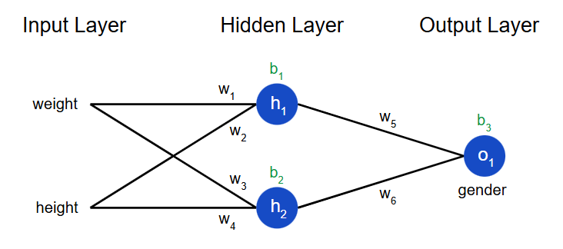
Parameters vs Hyperparameters
Parameters: Learned from data during training
E.g. : weights in linear regression or NN

Slide 4
Hyperparameters: Set before training, not learned
E.g. : learning rate, number of trees, max depth (in case of Random Forest), etc.

Slide 5
Methods of Hyperparameter Tuning
Manual Search – trial and error
Grid Search CV – test al combinations
Random Search CV – random subset of combinations

Slide 6
Grid Search CV
Exhaustive search over parameter grid
Uses cross validation to evaluate performance
Pros – Finds the best combo
Cons – Computationally expensive

Slide 7
Random Search CV
Samples random combinations from hyperparameter space
More efficient than grid search
Pros – Faster, handles large search spaces
Cons – Might miss the exact best set

Slide 8
Example (Random Forest)
Hyperparameters to tune:
n_estimators : number of trees in random forest
max_features : number of features to consider at every split
max_depth : maximum number of depth of each tree
max_samples : maximum number of samples each tree gets

Slide 9
n_estimators = [20, 60, 100, 120]
max_features = [0.2, 0.6, 1.0]
Max_depth = [2,8,None]
Max_samples = [0.5, 0.75, 1.0]

Slide 10
Fine-Tuning a Model
It is a transfer learning technique where a pre-trained model is adapted to a new, specific task or dataset.
Transfer learning??

Slide 11
Why fine-tune?
Saves time and computational cost
Works well when data is limited
Provides state-of-the-art performance on domain-specific tasks, etc…

Slide 12
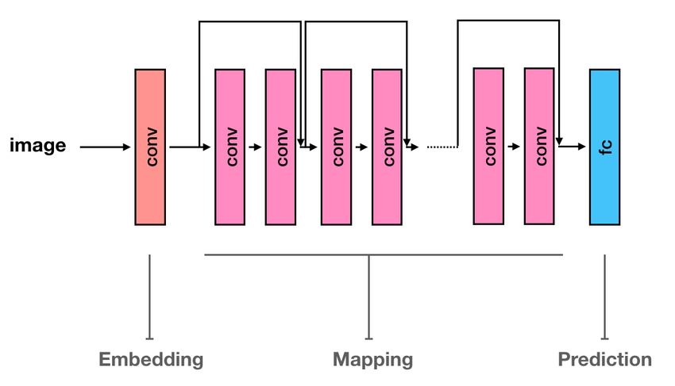
Fine-tuning in Computer Vision
Example: ResNet-50 Fine tuning
Pre-trained on ImageNet (1.2M images, 1000 classes)

Slide 13
Fine-Tuning in NLP/LLM
Example: Mistral-7B
Pre-trained on general text.
Fine-tuned for domain-specific tasks:
Sentiment Analysis
Customer Support Chatbot
Domain Q&A (medical, legal, finance)
Techniques:
Full fine-tuning (all parameters)
PEFT (LoRA /QLoRA)

